Slide 1

DAV 147
760th
Monthly Meeting

Slide 2

Call to Order

Slide 3

All Stand for the
Pledge of Allegiance

Slide 4
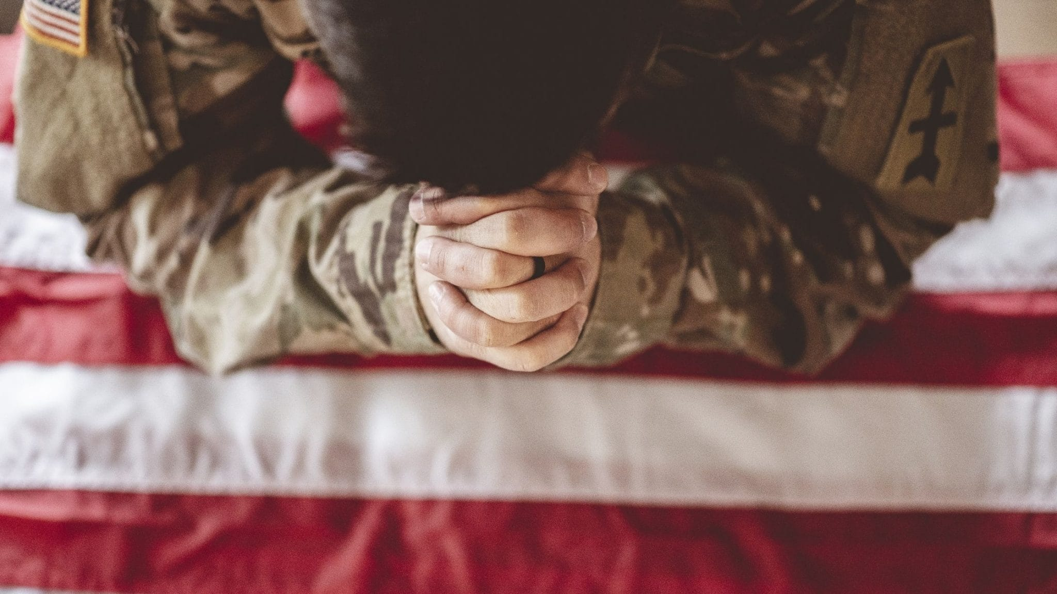
Opening Prayer Chaplain

Slide 5

Adjutant
Rollcall
Minutes
Communications

Slide 6


Finance Report Adrian Knotts

Slide 7
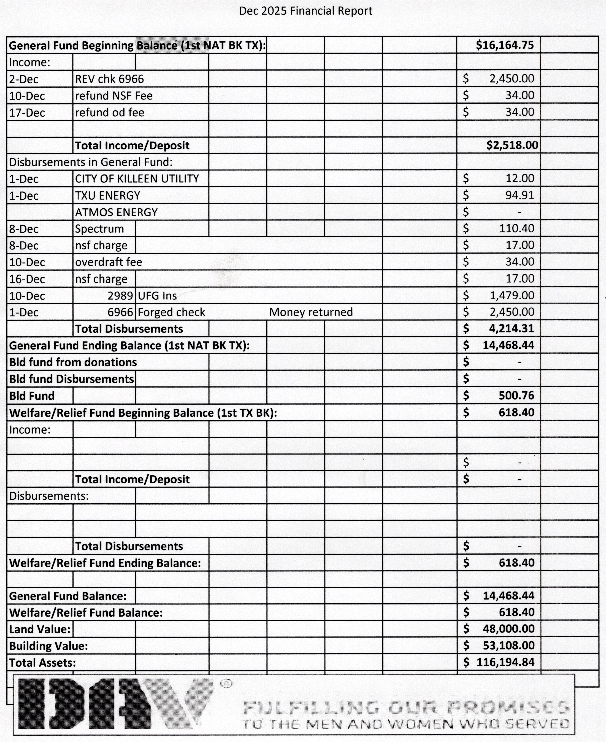

Slide 8
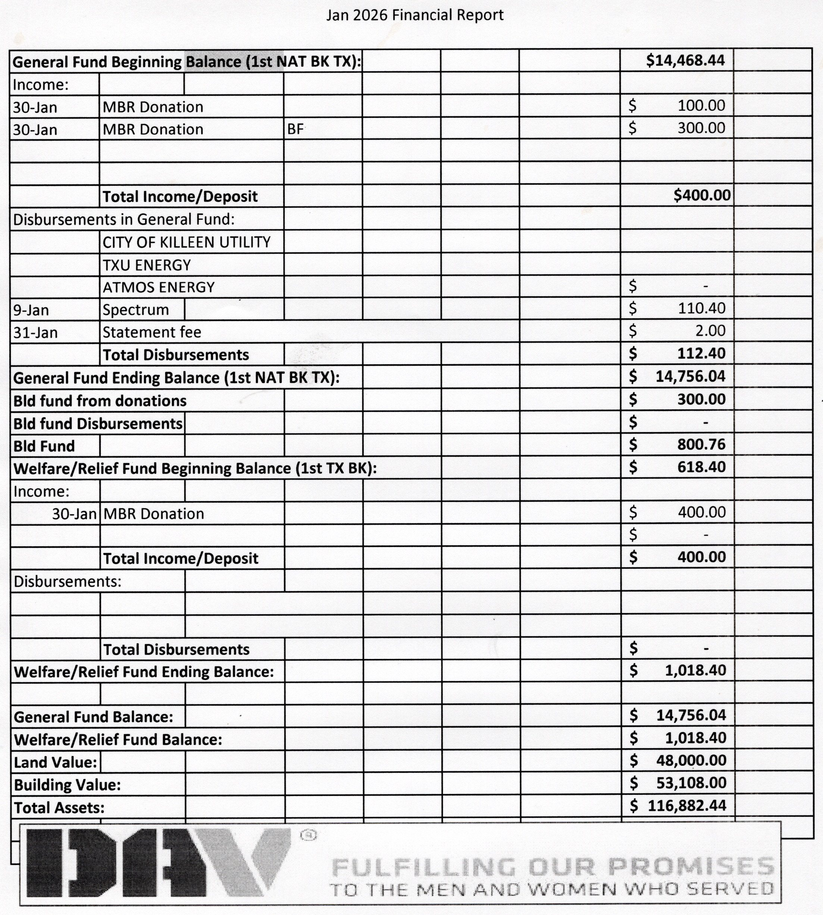

Slide 9
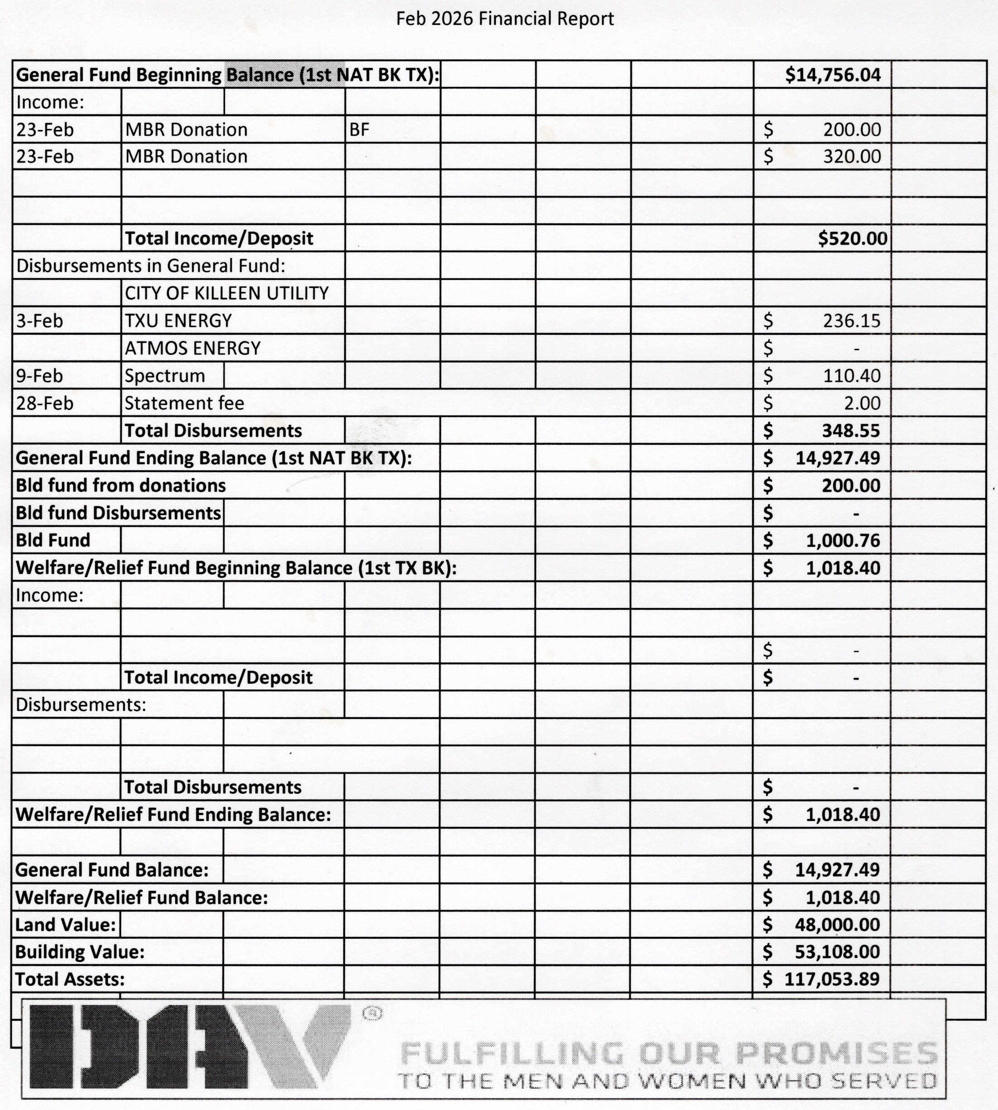

Slide 10


Slide 11

Sr. Vice Commander
Members 1868
LVAP Government Money Saved
1115 x 28 = $31,220.00

Slide 12

Members Added Last Year
93
Location Unknown

Slide 13

Jr. Vice Commander
Community & Claims

Slide 14

Community Information
On February 10 David Ferris from In the Zone came to re-certify Mike, Jose, Peter, Iris, Laurence and David at the chapter for the AS&K Course.
3. On February 19, the Commander and Jr. Vice Commander attended the In the Zone presentation.
4. On February 27 we held a fundraiser for our chapter's building fund. A total of 25 people assisted at that event. Thanks for all your support.

Slide 15
Claims
February Claims = 77

Slide 16

Old Business
Bathroom Remodeling
and
Insulating / Paint
placed on indefinite hold

Slide 17
Old Business
Connex Reimbursement
Change to Building Priorities
1.Roof – Shingles Brittle and falling off.
2.Electrical - Not in Code Compliance.

Slide 18


Slide 19


Slide 20
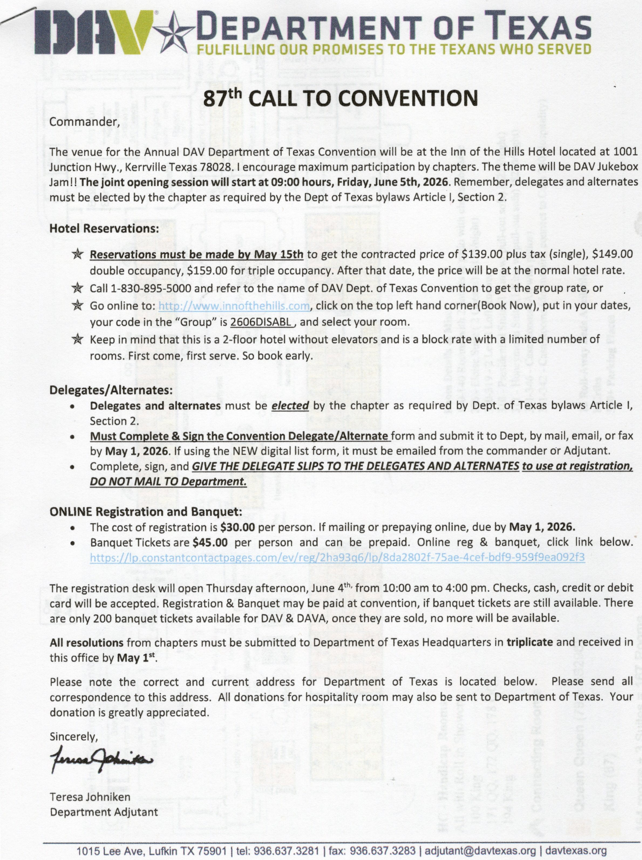

Slide 21
New Business
Forget Me Not Drive?
Anyone Interested?
Volunteers to commit and show up
When?
Where?

Slide 22
New Business
CSO Training at Cedar Hill Texas
Saturday, April 11th 2026

Slide 23
New Business
DAV Fund Raiser Dinners, Twice a month.
The dinner price will be from $15.00 to $20.00 depending on the meal.
Dinner @ DAV147 on March 27 Served from 5:00pm to 6:30pm

Slide 24
New Business Come and enjoy good food and great fellowship! See you there.
Dinner Menu
Chicken Breast with Gravy
Dressing
Mixed Veggies
Corn Bread
Dessert
Prepay $20.00 Donation Reserves your meal!
Cash Only
No Later than 3/27

Slide 25

June 13th 2026
More Information to come!

Slide 26

Empty Aluminum Cans
ALL
go into the Blue recycle bin.
Money goes into the Service Fund

Slide 27

Announcements
Donations
Office Supplies
Please Donate to the Service fund to pay for
Checks (made out to DAV147)
Cleaning Supplies
We DO NOT Accept Garage Sale Items

Slide 28






MOBILITY DEVICE REPAIR SERVICES
Give Scootaround a call or submit your case online.
No Consult Required!
We will take care of everything else!
We provide a single point of contact for the repair of your US Veterans Affairs
issued wheeled mobility devices.
Contact Scootaround and we will manage all aspects of the case from start to finish!
Toll-Free: 1-888-583-VETS(8387) or Scootaround.com/VA
Hours: Mon to Friday - 8:00 am to 9:00 pm EST.
Scootaround has an authorized contract with the US Department of Veterans Affairs.
Wheeled Mobility Repair Contract, Contract Number: 36C79123D0007

Slide 29

W.R. Hold DAV Anniversary Dinner
24 January 2026
59 Years
Social Hour: 5-6pm
Dinner: 6pm to 8pm
RSVP No Later Than 20th at end of day
To reserve your seat.

Slide 30
Volunteers Still Needed
Wednesday – Friday
12 Noon to 4.00pm
Maintenance of the Chapter.
Cutting Grass
Edging
General Clean up

Slide 31
Coffee Call & Meeting Info
Coffee Call April 4 @ 10am
Next DAV Meeting
April 17th @ 11am
Officers Call April 13th @ 9am

Slide 32
DAV Closed March 11 for CSO Cert.
Next Donation Dinner March 13. Pay $15 by 3/12
Spaghetti, Salad, Garlic Bread and Dessert!

Slide 33

Karaoke Tonight at 5:00 until bedtime Bring your own meal and adult beverage

Slide 34

Questions or Comments

Slide 35
50/50

Slide 36


Slide 37
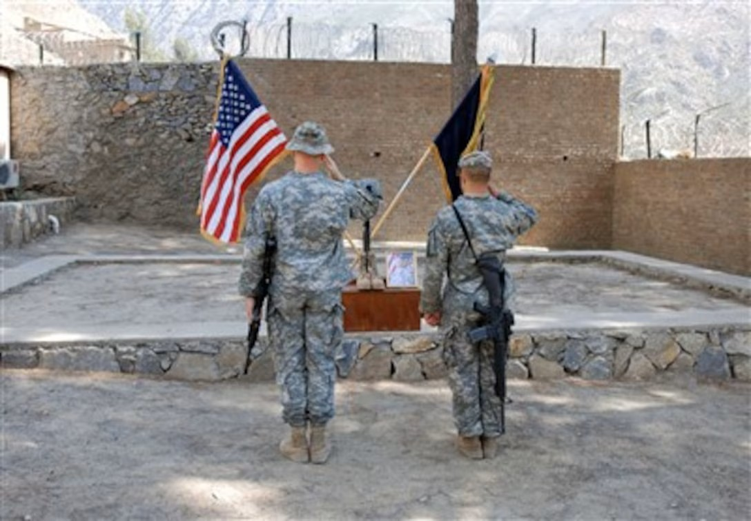
Render Honors

Slide 38
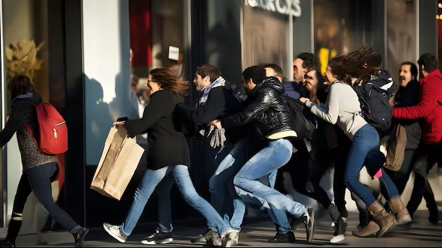
Meeting Adjourned

